Slide 1
COMP4710
Senior Design
Software Development Process

Slide 2
Outline
What are lightweight processes?
What is extreme programming?
What is pair programming?
Collaborative adversarial programming
Development deliverables
CAP demonstration

Slide 3
Lightweight Processes
Short development cycles
Small teams
State-of-the-art development tools
Design may be “overtaken by events”
Characteristic of Internet applications, mobile phones, connected gadgets, information appliances, games

Slide 4
What is eXtreme Programming?
XP is a deliberate and disciplined approach to software development.
XP is perfectly suited for risky projects with dynamic requirements.
XP emphasizes customer involvement and promotes team work.
XP trims unproductive and frustrating activities.
XP takes engineering best practices to an extreme level.

Slide 5
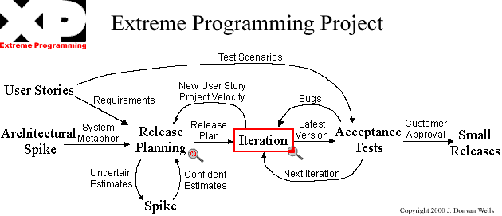
What is eXtreme Programming?
XP Process model

Slide 6
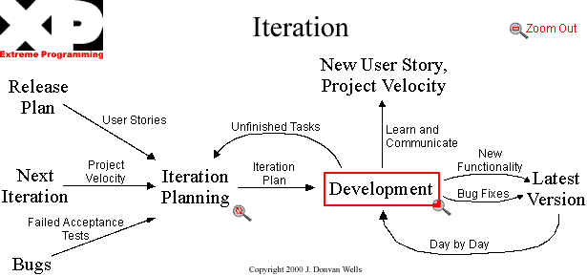
What is eXtreme Programming?
XP Iteration Model

Slide 7
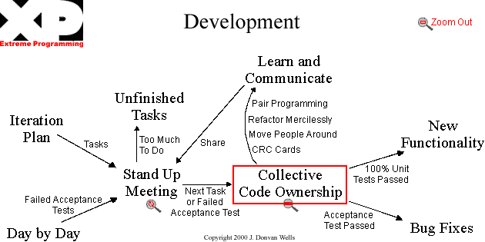
What is eXtreme Programming?
XP Development Model

Slide 8
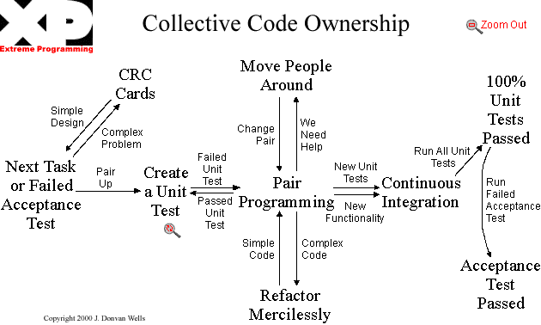
What is eXtreme Programming?
XP Code Ownership Model

Slide 9
What is eXtreme Programming?
XP Rules & Practices
  Planning
    User Stories are written
    Release Planning creates the schedule.
    Make frequent small releases.
    The Project Velocity is measured.
    The project is divided into iterations.
    Iteration Planning starts each iteration.
    Move people around.
    A stand-up meeting starts each day.
    Fix XP when it breaks.

Slide 10
What is eXtreme Programming?
XP Rules & Practices
  Designing
    Simplicity.
    Choose a System Metaphor.
    Use CRC cards for design sessions.
    Create spike solutions to reduce risk.
    No functionality is added early.
    Refactor whenever and wherever possible.

Slide 11
What is eXtreme Programming?
XP Rules & Practices
  Coding
    The customer is always available.
    Code must be written to agreed standards.
    Code the unit test first.
    All production code is pair programmed.
    Only one pair integrates code at a time.
    Integrate often.
    Use collective code ownership.
    Leave optimization till last.
    No overtime.

Slide 12
What is eXtreme Programming?
XP Rules & Practices
  Testing
    All code must have unit tests.
    All code must pass all unit tests before it can be released.
    When a bug is found tests are created.
    Acceptance tests are run often and the score is published.

Slide 13
What is Pair Programming?
Two programmers working side-by-side, collaborating on the same design, algorithm, code or test on one computer.
One programmer, the driver, has control of the keyboard/mouse and actively implements the program.
The other programmer, the observer, continuously reviews the work of the driver to identify tactical (syntactic, spelling, etc.) defects and also thinks strategically about the direction of the work.
At any time the two programmers can brainstorm any challenging problem.
The observer & driver periodically switch roles.

Slide 14
Pair Programming Effects
Continuous Reviews
  Many mistakes are caught as they are typed in.
  The end product as significantly fewer defects.
Pair Relaying
  The effect of two people working together to solve a problem.
Pair Learning
  It has been shown that two people can learn a new concept faster than solitary learning.
Pair Pressure
  A positive pressure between the two programmer’s contributes to their success.

Slide 15
Pair Programming Benefits
Economics – early defect detection and removal reduces costs.
Satisfaction – people working in pairs find the experience more enjoyable than working alone.
Design Quality – pairs tend to produce shorter programs which is indicative of superior design.
Continuous Reviews – very effective for early defect detection and removal.
Problem Solving – pairs tend to solve problems faster than individually.
Learning – the partners help each other learn new concepts.
Team Building & Communication – pair programming requires team work and members to effectively communicate.

Slide 16
Collaborative Adversarial Programming
CAP is pair-programming without the co-location requirement.
Co-located
Separate
Co-located
Sandbox
Code
Collaborate
Review
Test

Slide 17
Collaborative Adversarial Programming
CAP Variant
Co-located
Separate
Co-located
Sandbox
Code
Collaborate
Review
Test

Slide 18
Collaborative Adversarial Programming
SDP CAP Artifacts
1
Design Artifact
Source Code
Unit/Acceptance Tests
Review Log
2
3
4
Code
2
1
4
Collaborate
Review
Test
3

Slide 19
The Senior Design Process Model
SDP Process Model
New/Refined User Stories
User
Stories
Requirements
Planning
System Metaphor
Final Build/Release
Package
Mgmt. Plan
Final
Release
Cycle
Iteration
Arch.
Spike
Unfinished Stories/
Next Cycle
AU OK
Cert.
Submission Package

Slide 20
The Senior Design Process Model
SDP Iteration Model
Refined User
Stories
Iteration
Planning
Mgmt. Plan
Unfinished Stories
User
Stories
Refactor
Cycle
Intent
New/Refined User
Stories
Accept. Tests
Refactored Code Base
Failed
Tests
New Features
Next Cycle
Cycle
Release
Development
Release Plan
Completed
User Stories

Slide 21
The Senior Design Process Model
SDP Development Model
Code Complete
Review Issues
Write Code
Mgmt. Plan
Design Artifact
Test
Failed Tests
User
Stories
Develop Tests
Collaborate
All Tests
Pass
Design Artifact
Review
Integrate
Team
Signoff

Slide 22
CAP Demonstration
Mill class design artifact
Mill
+ char charMill(char c)
+ String stringMill(String s)
The Mill class processes strings and characters to their “printable character only” equivalents. Non-printable characters ((c < space) or (c > tilde)) are treated as spaces.
charMill(c) converts c returns the printable character for c based on the general Mill statement above.
stringMill(s) returns the printable version of s based on the general Mill statement above. The returned string should have no leading or trailing spaces and should not have any consecutive space characters.

